Slide 1

Automated Cyberbullying Detection System
This project aims to create an NLP-based system to identify offensive and hateful comments on social media platforms. The goal is to reduce user exposure to cyberbullying and promote a safer online environment.

Slide 2

Project Objectives
1
Detect Harmful Content
2
Improve User Experience
3
Support Mental Health
Develop an NLP system to identify offensive and hateful comments on social media.
Reduce exposure to cyberbullying and promote a safer online environment.
Mitigate psychological impacts like anxiety, depression, and low self-esteem.

Slide 3
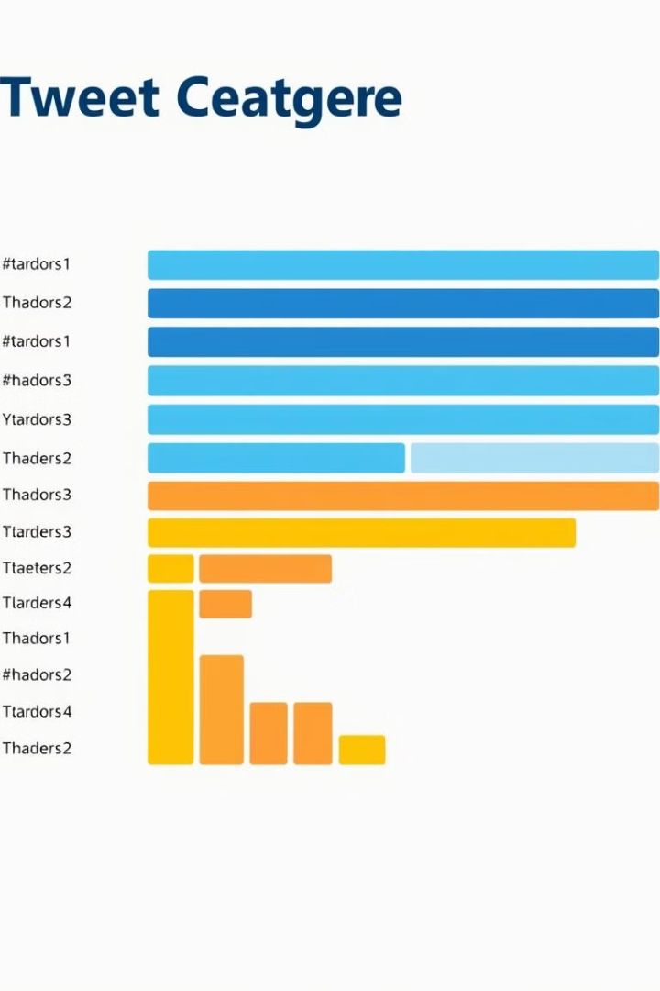
Data Source and Structure
Source
Hugging Face's "tdavidson/hate_speech_offensive"
Content
Tweets labeled for hate speech, offensive language, or neither
Columns
count, hate_speech_count, offensive_language_count, neither_count, class, tweet

Slide 4





Key Stakeholders
Social Media Users
Moderation Teams
Benefit from reduced exposure to offensive language.
Need tools to effectively monitor and control comment sections.
Data Scientists
Executive Leadership
Interested in building and refining cyberbullying detection models.
Focused on user retention, satisfaction, and brand reputation.

Slide 5
Project Methodology
Business Understanding
1
Define problem, objectives, and stakeholders for cyberbullying detection strategy.
2
Data Understanding
Collect and explore datasets with labeled comments categorized by severity.
Data Preparation
3
Clean and preprocess text data, handling misspellings, slang, and emojis.
4
Modeling
Use NLP techniques and train neural network models for text classification.
Evaluation
5
Assess model performance using metrics like accuracy for text classification.

Slide 6
Data Analysis Insights
Class Distribution
Tweet Lengths
Correlations
Class 1 (offensive language) most common with 19,190 tweets. Class 2 (neutral) has 4,163 tweets. Class 0 (hate speech) least frequent with 1,430 tweets.
Hate speech tweets generally longer, averaging 95 characters. Offensive language tweets show most diverse range of lengths.
Moderate negative correlation between hate speech and offensive language counts. Strong positive correlation between neutral count and higher class labels.

Slide 7
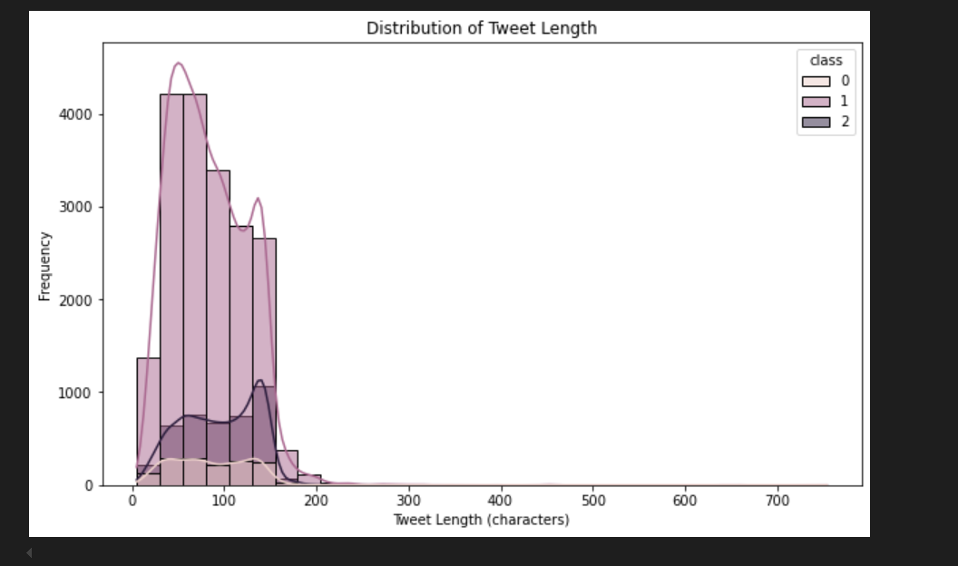
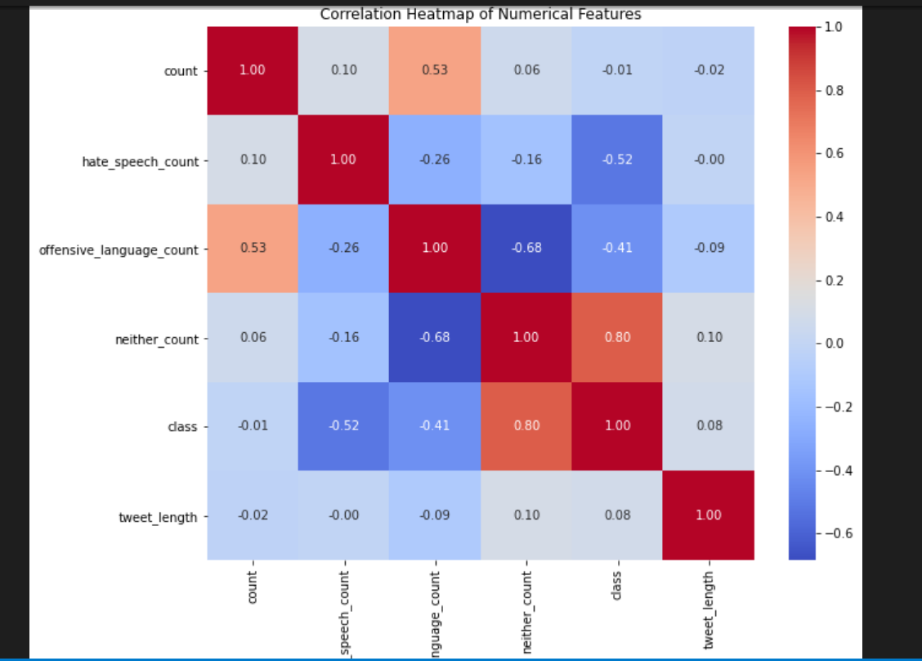
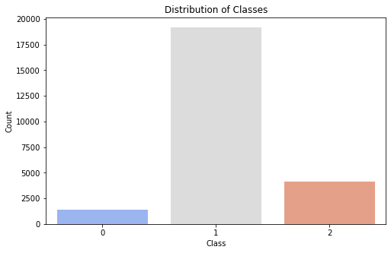
Data Analysis Insights
Class Distribution
Tweet Lengths
Correlations

Slide 8
Text Processing
Removal of stop words
Handling imbalance
Tokenization & Padding
Removal of stop words for easier classification of texts as stop words may not have significant meaning to texts. It is also useful to reduce dimensionality.
Class_weight is a dictionary where the keys are the class indices and the values are weights assigned to each class. This helps adjust the model’s learning process to give more importance to the underrepresented classes in the dataset.
Tokenize the tweet columns to individual words.
Convert texts to sequences.
Define a max length for truncating the sequences before padding.
Padding the train data

Slide 9

Modeling Approach
CNN Base Model
Global Max Pooling Model
Simple model to test performance on training data. Achieved 86% accuracy.
Used to reduce dimensionality and focus on important features. Achieved 68% accuracy.
Bidirectional LSTM Model
Captured sequence context for comprehensive feature representation. Achieved 84% accuracy.

Slide 10




Best Model Selection
CNN base model
Global max pooling Model
Bidirectional LSTM Model
High accuracy of 86% compared to the other two models hence selected.
Moderate accuracy but showed signs of underfitting. Not selected.
Had an accuracy of 84% second highest accuracy but not selected.

Slide 11
Evaluation Approach
Accuracy on the test data
Precision on the test data.
The accuracy obtained from the test data was 72%. This shows that our model is able to predict 72% of test data or unseen data
The precision obtained from the test data is 54%. This shows that the model can be able to identify instances of positive tweets.
Recall on the test data
The recall obtained was 59%. This shows that the model was able to correctly identify 59% positive instances.

Slide 12
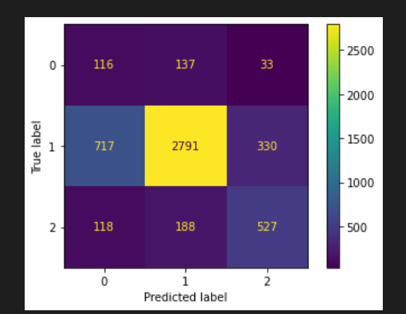

Slide 13
Conclusions
1.
The system achieved high accuracy of 91% being able to detect offensive and hateful language, indicating that the system can reliably identify harmful comments based on the user input in prediction of tweets part. Making it suitable for practical applications.
2.
The use of bidirectional LSTM in the third model significantly improved performance by capturing the context and sequential dependencies of language data.
3.
The system was able to mitigate cyberbullying actions such as offensive language, hate speech which depreciate the mental health of the users which is a growing concern for social media users.

Slide 14
Recommendations
1. Incorporate a user reporting mechanism - To further improve the system, a reporting feature is recommendable to allow users to report the other users who leave negative or hateful comments on their page.
2. Expand the system to other languages - With users coming from different countries and the social platforms been interpreted in different languages, it will be useful if the model is designed further in a way to interpret different languages.

